Slide 1

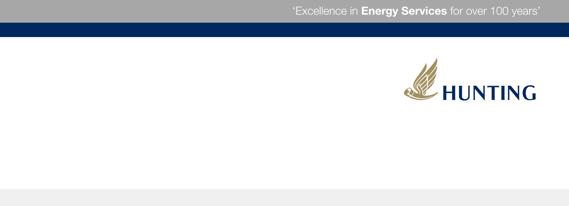
International Perforating Symposium (IPS) 2016
A Method of Mapping and Perforating Wells with Fiber Optics Outside Casing on Wireline

Slide 2

AGENDA/INTRODUCTION
Magnetic Orienting Perforating Tool
History
Theory
Specifications
Features
Benefits
Log Interpretation
Logging Parameters
Testing
Questions
This tool provides the ability to log and perforate in Smart Well environments that utilize Fiber Optics
IPS 16-19
A Method of Mapping and Perforating Wells with Fiber Optics Outside Casing on Wireline

Slide 3
History
Mechanical orienting tools have been used for years in dual and multi-string completions to prevent damage of adjacent strings
Recent upgrades have enabled:
  Better log quality in multi-string completions
  The ability to identify and perforate in wells that have fiber optics on the outside of the casing
IPS 16-19
A Method of Mapping and Perforating Wells with Fiber Optics Outside Casing on Wireline

Slide 4
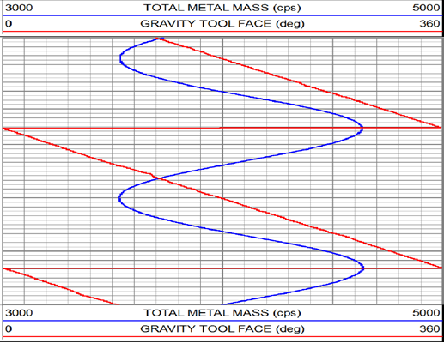
Theory
Tool has an electromagnetic exciter that creates a low frequency 360° magnetic field centered axially about the tool
Directional receivers measure phase change between the primary and secondary magnetic fields to show changes in metal mass as the tool is rotated
Phase change is measured and used to generate a curve that is proportional to metal mass verses an angular position in relationship to the tool
  Higher Phase Shifts = increasing metal mass
  Lower Phase Shifts = decreasing metal mass
A two axis accelerometer is used for Deviation and Gravity Tool Face
  Shows relation of the increased area of metal mass to the high side of the casing/tubing
MOT Reading
High Metal Mass
Low Metal Mass
IPS 16-19
A Method of Mapping and Perforating Wells with Fiber Optics Outside Casing on Wireline

Slide 5
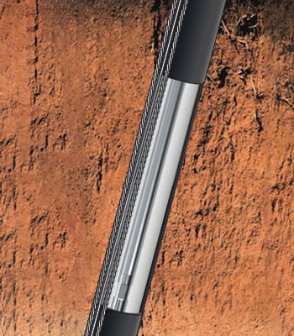
Specifications
Rated to 365°f [185°c]
Rated to 18,000 psi
Used as a logging/perforating tool and can be run with guns to allow single run operations
Used to help identify corkscrewed tubing
Smaller footprint than other tools on the market
Can be used in conjunction with addressable systems to shoot multiple guns on a single run
IPS 16-19
A Method of Mapping and Perforating Wells with Fiber Optics Outside Casing on Wireline

Slide 6
Features
Telemetry data – 40 samples per second of all measured parameters
Borehole inclination is accurate from 5° to 45°
Gravity Tool Face (High Side Indicator) is accurate from 2° up to 100°
Metal mass measurement to detect collar or other magnetic anomalies in the pipe or casing
Continuous cable head voltage and internal tool temperature updates
IPS 16-19
A Method of Mapping and Perforating Wells with Fiber Optics Outside Casing on Wireline

Slide 7
Benefits
Operation of tool easily controlled using wireline voltage settings
Increased magnetic directional sensitivity for better target resolution
No need for an additional external panel
Increased data quality with the help of the high side indicator and inclination along with the MOT readings
Metal thickness curve eliminates need to run a CCL and helps to identify casing defects as well as anomalies outside of casing
IPS 16-19
A Method of Mapping and Perforating Wells with Fiber Optics Outside Casing on Wireline

Slide 8
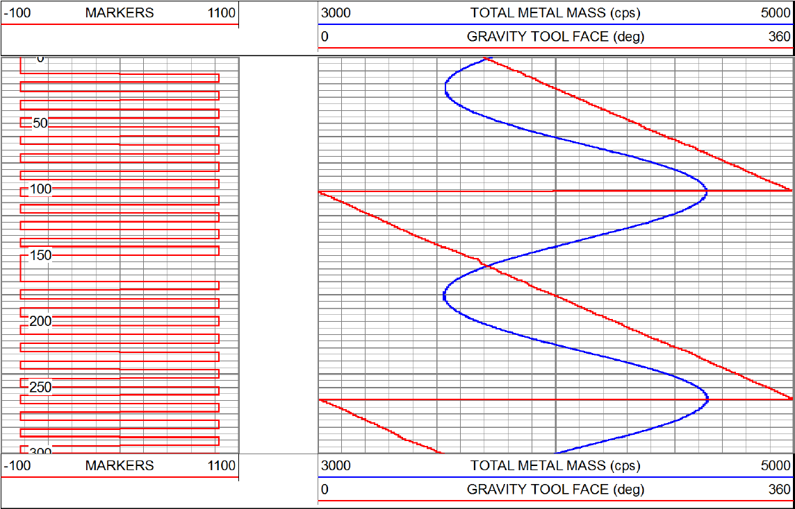
Log Interpretation
Casing
Steel Cable
Fiber Optic Cable
Steel Cable
High Side Indicator
MOT Tool
MOT Reading
IPS 16-19
A Method of Mapping and Perforating Wells with Fiber Optics Outside Casing on Wireline

Slide 9
Logging Parameters
Increasing metal mass surrounding the fiber optics line improves the tools response
At least 5 degree deviation is needed
  Provides good high side indication
  Provides ability to monitor the relationship of high metal mass and high side
Marker Switch or High Side Indicator can be used to identify:
  Corkscrewed Tubing
  Twisted Cable around Casing
Actively monitors internal temperature to ensure tool reliability
Markers are used to help ensure tool anchor is not slipping
IPS 16-19
A Method of Mapping and Perforating Wells with Fiber Optics Outside Casing on Wireline

Slide 10
Testing
> 48 Wells at max temperatures of 267°f
> 400 perforating runs
Not one fiber optics string was hit during testing
Tested based on parameters set by client
  Required at least 2 degree deviation
  Wells included areas that did not have metal mass beside fiber optics to establish a baseline
  Cannon clamps were used over collars to protect and align fiber optic cables
IPS 16-19
A Method of Mapping and Perforating Wells with Fiber Optics Outside Casing on Wireline

