Slide 1

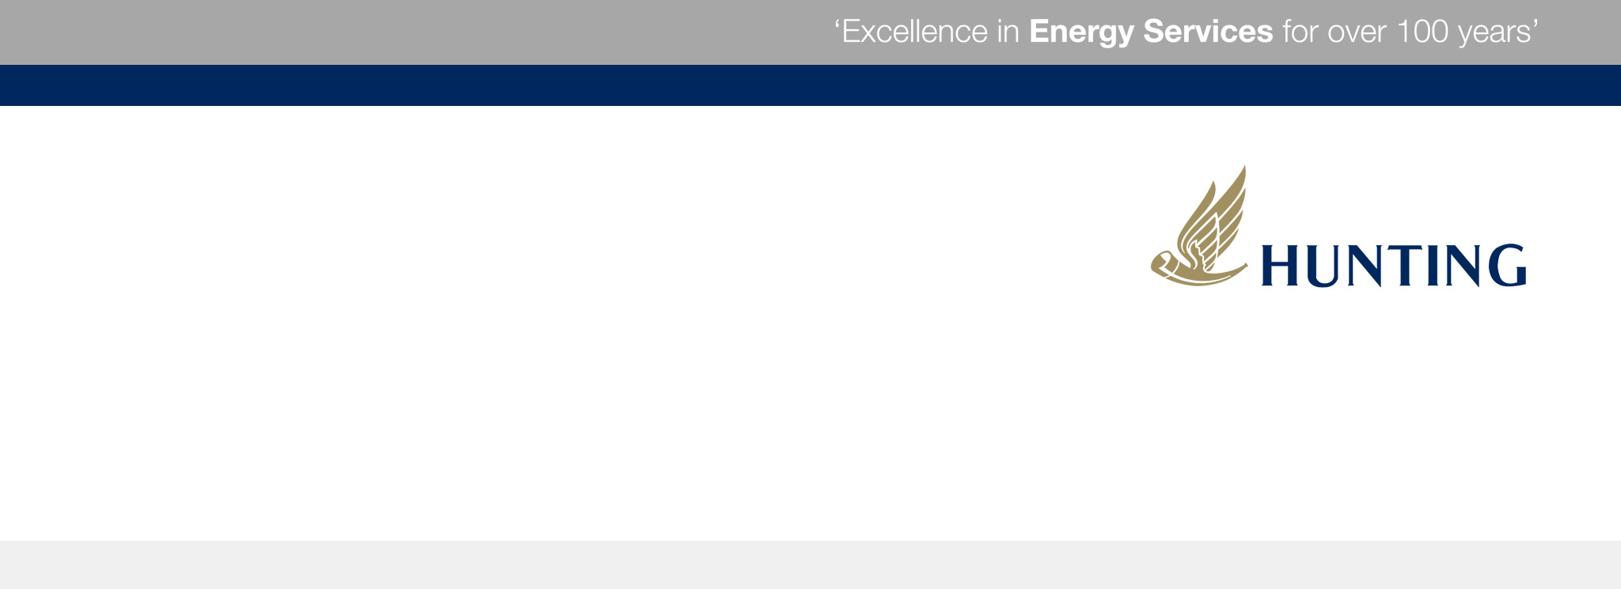
International Perforating Symposium (IPS) 2016
Advancing Consistent Hole Charge Technology to Improve Well

Slide 2

AGENDA/INTRODUCTION
Consistent Hole (CH) Technology
Growth in a Down Market
Opportunities for Advancement
Review of Published Data
Comparison of Charges in Common Well Configurations
Guidelines for Selection, Evaluation, Comparison and Feedback
Recommendations for Improvement to API RP19B
IPS 16-10
Advancing Consistent Hole Charge Technology to Improve Well Productivity

Slide 3
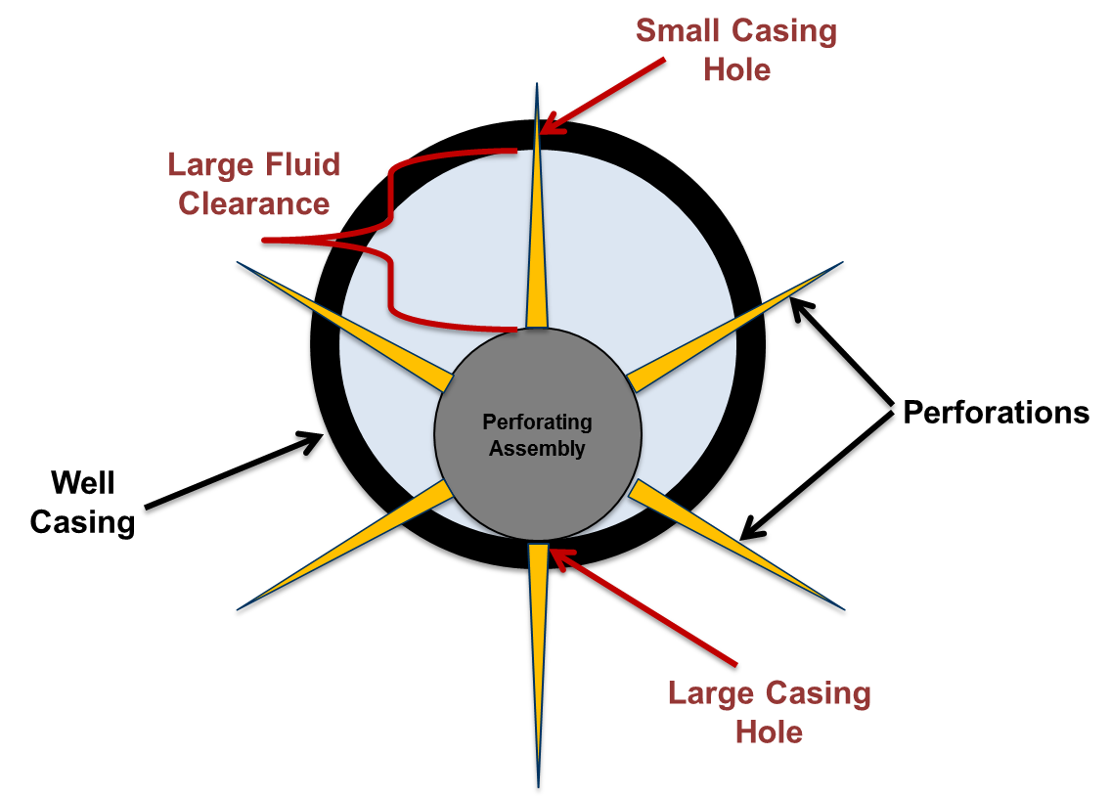
Conventional DP and GH Shaped Charges
Non-uniform distribution of treating fluids
Erosion and slotting of small perforations
Under-utilization of all perforations
Less efficient well stimulation
Slow ramp-up to higher treating pressures
IPS 16-10
Advancing Consistent Hole Charge Technology to Improve Well Productivity

Slide 4
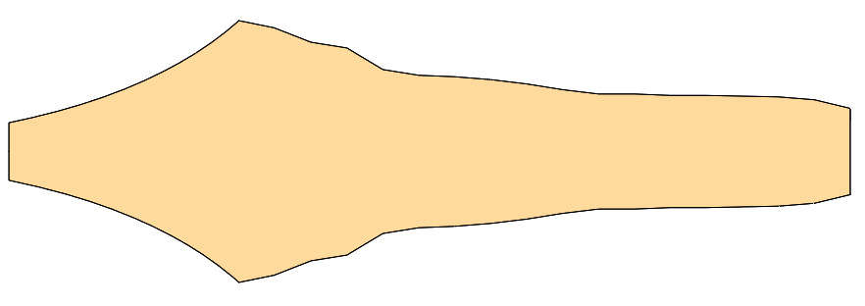
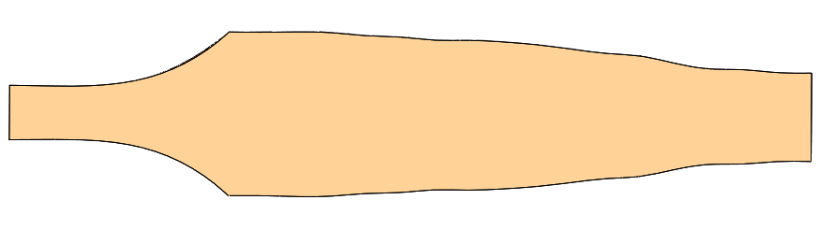
Shaped Charge Jet Profiles
Common P-110
Common P-110
API Standard L-80
API Standard L-80
Conventional Shaped Charge
Consistent Hole Technology
Wide Jet Profile
Narrow Jet Profile
Uniform Jet Profile
IPS 16-10
Advancing Consistent Hole Charge Technology to Improve Well Productivity

Slide 5
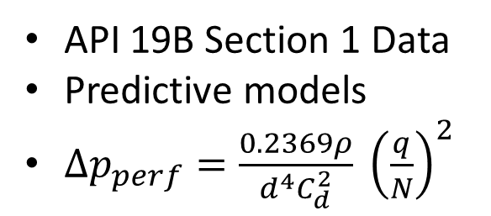
Importance of CH Technology
Planned Hole Size & Flow Area
Correction Factors
Well Stimulation Plan
Variable Hole Size & Flow Area
Unused Perforations
API 19B Section 1 Data
Predictive models
$∆p_{perf}=\frac{0.2369ρ}{d^{4}C_{d}^{2}} {\left(\frac{q}{N}\right)}^{2}$
IPS 16-10
Advancing Consistent Hole Charge Technology to Improve Well Productivity

Slide 6
Importance of Consistent Hole Technology
CH Technology
Planned Hole Size & Flow Area
Actual Hole Size & Flow Area
Well Stimulation Plan
Consistent Hole Technology enables opportunity for optimal well stimulation
IPS 16-10
Advancing Consistent Hole Charge Technology to Improve Well Productivity

Slide 7
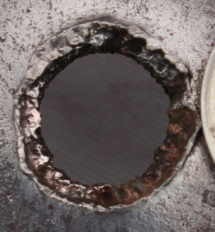
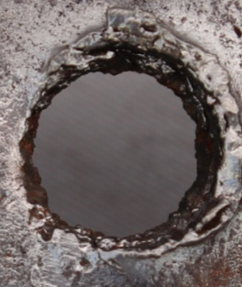
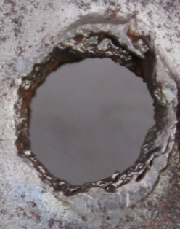
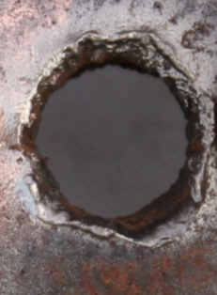
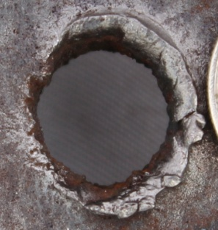
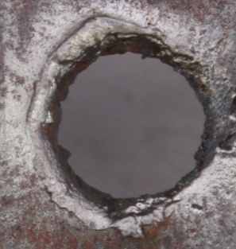
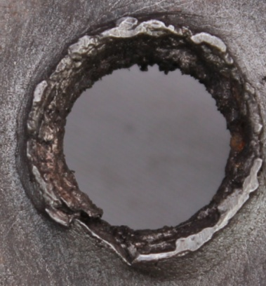
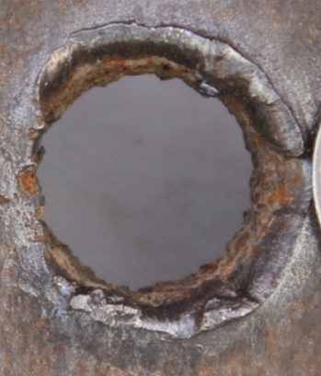
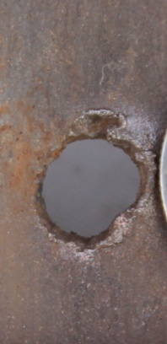
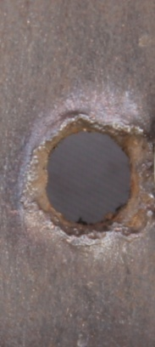
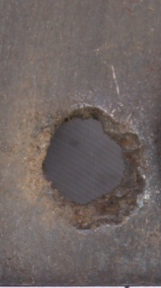
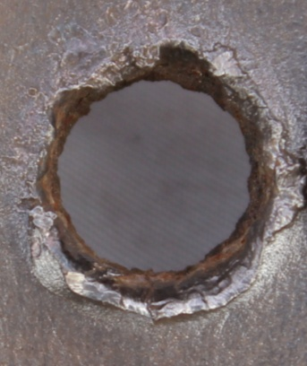
Consistent Hole Shaped Charges
CH Technology
New category of shaped charges
Designed for decentralized perforating
Improves efficiency of well stimulation
Achieves consistent hole size regardless of fluid clearance
Advertised with Average Hole Size AND Variation in Hole Size
0°
0.2 in
60°
0.5 in
120°
1.1 in
180°
1.5 in
240°
1.1 in
300°
0.5 in
Conventional Charge
IPS 16-10
Advancing Consistent Hole Charge Technology to Improve Well Productivity

Slide 8
Consistent Hole Market Trend
Growth in a Down Market
CH Technology has seen significant growth despite a 50% reduction in the overall charge market
IPS 16-10
Advancing Consistent Hole Charge Technology to Improve Well Productivity

Slide 9
Consistent Hole System Growth
Exponential growth in availability of CH perforating systems
Growth driven by market demand for efficient technology
IPS 16-10
Advancing Consistent Hole Charge Technology to Improve Well Productivity

Slide 10
Why Growth in Consistent Hole Technology?
…operator Increased Injectivity by 20%
…evaluated 15 frac stages to show Lower Treating Pressures at the same pump rate or 8-10% higher pump rate
…two well studies show 10% Reduction in Breakdown Pressure, 2% Reduction in Treating Pressure, and 3% Increase in Proppant Placement
…Reduced Injection Pressure by 15%
…achieved and maintained Faster Pump Rate with Reduced Stimulation Pump Pressure
…More Consistent Treating Rate with Increased Sand Concentration at Lower Pressure
…Decentralized CH charge resulted in 10% Higher Treating Rate than a Centralized DP charge
Case study information compiled from multiple CH technology providers
IPS 16-10
Advancing Consistent Hole Charge Technology to Improve Well Productivity

Slide 11
Advancing Consistent Hole Technology
Existing case studies highlight benefits of CH Technology utilizing the same well simulation method
Good News!!
These studies have established a foundation for CH Technology
Are current well simulation methods and designs best?
IPS 16-10
Advancing Consistent Hole Charge Technology to Improve Well Productivity

Slide 12
Advancing Consistent Hole Technology
Conventional Shaped Charges
Consistent Hole Technology
Variation in hole size (a key design input) yields unpredictable stimulation result
Accept that actual results differ from design – often without explanation
Consistent hole size increases control and predictability of stimulation → More strategic placement of perforations
Removing hole size variability provides opportunity to investigate difference between design and actual results → Increased understand of effective stimulation
IPS 16-10
Advancing Consistent Hole Charge Technology to Improve Well Productivity

Slide 13
Advancing Consistent Hole Technology
CH Technology
Unlikely that the same stimulation design is optimal for both perforation profiles
0°
0.2 in
60°
0.5 in
120°
1.1 in
180°
1.5 in
240°
1.1 in
300°
0.5 in
Conventional Charge
IPS 16-10
Advancing Consistent Hole Charge Technology to Improve Well Productivity

Slide 14
Advancing Consistent Hole Technology
Select the optimal CH Technology – use CH Technology with distinctly different performance from conventional charges
Evaluate down hole performance – comparable baseline, ideally different stages in the same well
Provide feedback – what worked? Where is the opportunity for improvement?
IPS 16-10
Advancing Consistent Hole Charge Technology to Improve Well Productivity

Slide 15
Selecting Advanced Consistent Hole Technology
Company A
Number of Systems: 8
Size Range: 2-1/2” – 4-1/2”
Casing: Common size, grade, weight
Several perforating systems currently available
Anticipate increase in options:
  Broad range of systems optimized for different casing sizes, weights, and strength
  Broad range of hole size options tailored for various well stimulation techniques
CAUTION! Variation from tests in low grade, small diameter or low weight casing does not reflect performance in common casing.
Company B
Number of Systems: 3
Size Range: 2-3/4” – 3-3/8”
Casing: Unknown grade, weight
Company C
Number of Systems: 3
Size Range: 3-1/8” – 3-3/8”
Casing: Low grade and small dia. or low weight
IPS 16-10
Advancing Consistent Hole Charge Technology to Improve Well Productivity

Slide 16
Selecting Advanced Consistent Hole Technology
 | Gun Size | Casing | Hole Size | Variation | Test
Company A | 2-1/2" | 4-1/2" 13.5# P-110 | 0.29 | 7.3% | Gun
 | 2-3/4" | 4-1/2" 13.5# P-110 | 0.38 | 6.8% | 19B
 | 2-3/4" | 5-1/2" 23# P-110 | 0.33 | 5.9% | Gun
 | 3-1/8" | 4-1/2" 13.5# P-110 | 0.40 | 2.5% | 19B
 | 3-3/8" | 5-1/2" 23# P-110 | 0.38 | 4.9% | 19B
 | 3-3/8" | 5-1/2" 23# P-110 | 0.44 | 5.9% | Gun
 | 4" | 7” 29# P-110 |  |  | Gun
 | 4-1/2" | 7” 29# P-110 |  |  | Gun
Company B | 2-3/4" | 4-1/2" | 0.41 | 22.0% | Unk.
 | 3-1/8" | 4-1/2" | 0.46 | 10.9% | Unk.
 | 3-3/8" | 5-1/2" | 0.43 | 25.6% | Unk.
Company C | 3-1/8" | 4-1/2" 11.6# L-80 | 0.48 | 7.1% | 19B
 | 3-3/8" | 4-1/2" 11.6# L-80 | 0.50 | 6.6% | 19B
 | 3-3/8" | 5-1/2" 17# L-80 | 0.45 | 13.4% | 19B
Low variation in high strength casing
Moderate to high variation in unknown casing strength
Low to moderate variation in low strength casing
IPS 16-10
Advancing Consistent Hole Charge Technology to Improve Well Productivity

Slide 17
0.24
0.52
3-3/8” 6 SPF 60 deg. Gun
5-1/2” 23# P-110
0.40
0.26
0.24
0.46
0.45
0.33
0.30
0.25
0.25
0.40
0.42
0.48
0.50
0.46
0.46
0.42
0.51
0.52
Company A
Average: 0.43 in.
Min: 0.40 in.
Max: 0.46 in.
Variation: 5.9%
Company C
Average: 0.39 in.
Min: 0.26 in.
Max: 0.51 in.
Variation: 32.6%
Conventional GH
Average: 0.36in.
Min: 0.24 in.
Max: 0.52 in.
Variation: 35.7%
API Test: 5-1/2” 23# P-110
API Test: 5-1/2” 17# L-80
IPS 16-10
Advancing Consistent Hole Charge Technology to Improve Well Productivity

Slide 18
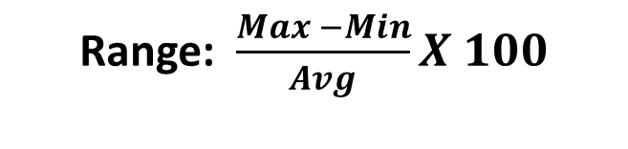
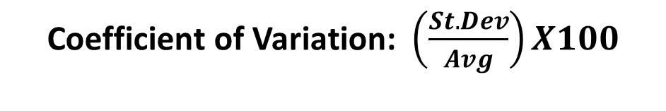
Calculation of Variation
Range: $\frac{Max −Min}{Avg}X 100$
Coefficient of Variation: $\left(\frac{St. Dev}{Avg}\right)X100$
System | Min | Max | Range | % Range | CV
Comp. A 3-3/8” (5-1/2” P-110) | 0.39 | 0.47 | 0.08 | 18.3% | 5.9%
Comp. C 3-3/8” (5-1/2” L-80) | 0.35 | 0.53 | 0.18 | 40.1% | 13.4%
Important
Statistically Important
IPS 16-10
Advancing Consistent Hole Charge Technology to Improve Well Productivity

Slide 19
Selection Principles
Only compare performance data for charges tested:
  Casing of equivalent or higher strength/weight
  Fluid clearance of equivalent or greater distance
Ensure the same calculation method is used when comparing variation
Verify suitable Quality Control for CH Technology
  CH Charges require more stringent QC methods
  Review manufacturer’s QC procedure
IPS 16-10
Advancing Consistent Hole Charge Technology to Improve Well Productivity

Slide 20
Recommendations for API Standardized Testing
Decentralize perforating gun
Align perforating gun with one bank of shots at the minimum and maximum fluid clearances
Common casing strength (i.e. P-110 casing)
Common casing size (i.e. 5-1/2” casing for 3-3/8” gun)
Minimum of two shots at each fluid clearance
IPS 16-10
Advancing Consistent Hole Charge Technology to Improve Well Productivity

Slide 21
Recommendation for Data Publishing
Gun Size | Casing | Min | Max | Avg. | Range | CV
3-3/8” | 5-1/2” 23# P-110 | 0.39 | 0.47 | 0.44 | 0.08 | 5.9%
OD, Weight, Grade
Specific Hole Size Range
Comparison Values
IPS 16-10
Advancing Consistent Hole Charge Technology to Improve Well Productivity

Slide 22
Conclusion
Consistent Hole Technology’s market presence is expected to increase
Consistent Hole Technology has proven to reduce stimulation costs
There is need for standardized testing and data publication
Next Phase:
Optimizing stimulation design with Consistent Hole Technology to increase well productivity
IPS 16-10
Advancing Consistent Hole Charge Technology to Improve Well Productivity

