Slide 1


International Perforating Symposium (IPS) 2016
Mitigating the Problems in Select-Fire Perforating Operations

Slide 2

AGENDA
Reported Failures
Objectives of the System
Safety Benefits
Service Quality Solutions
Operational Benefits
System Overview
Conclusion
Questions
IPS 16-22
Mitigating the Problems in Select-Fire Perforating Operations

Slide 3
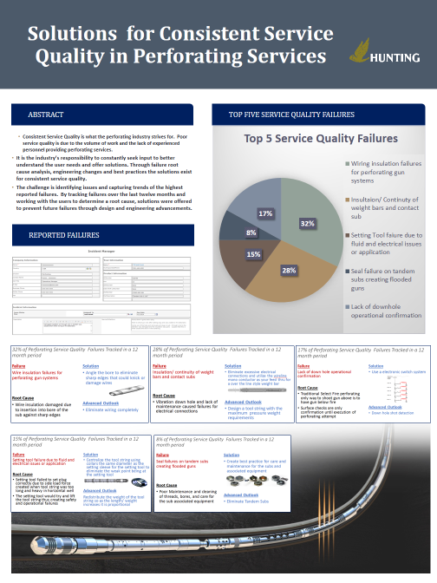
Reported Failures
CIPS 2014 Poster Session “Solutions for Consistent Service Quality in Perforating Services”
18 month period 750+ Reported Select Fire Issues/ problems
38% Pinched or nicked lead wire
22% Seal failure
18% Lack of operational confirmation (Not being able to check individual guns down hole and or unable to fire upper gun unless lower gun fired with mechanical actuation)
IPS 16-22
Mitigating the Problems in Select-Fire Perforating Operations

Slide 4
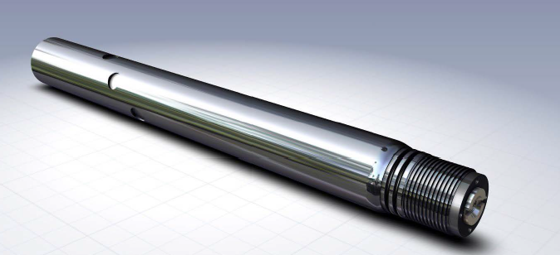
Objectives of the System
Added level of safety to prevent surface detonations
Eliminate service quality failures in select fire perforating
Ease of use for operational efficiency
Reduce footprint for extended laterals with increased perf clusters
Advanced technology for today’s perforating market
IPS 16-22
Mitigating the Problems in Select-Fire Perforating Operations

Slide 5
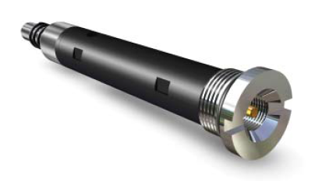
Safety Benefits
Initiation cartridge uses intelligent, electronic switch technology
Added level of safety
  Electrically unarmed
  Protection up to 500V
RF SAFE
API RP 67 Compliant
Third Party Tested
IPS 16-22
Mitigating the Problems in Select-Fire Perforating Operations

Slide 6
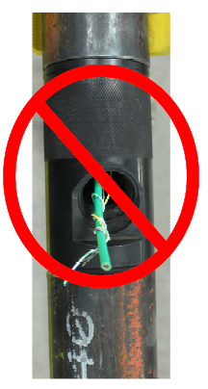
Safety Benefits
Shorter tool string
  4-6” per gun connection
Lighter tool string
  18# lighter per gun connection
Reduced pinch points
No exposed detonating cord
IPS 16-22
Mitigating the Problems in Select-Fire Perforating Operations

Slide 7
Service Quality Solutions
Failure - Pinched or nicked lead wire
Solution - Eliminate wires
Failure - Seal Failure
Solution - Eliminate ports and tandem subs
Failure- Lack of operational confirmation
Utilize proven intelligent electronic select-fire system which confirms shot gun
IPS 16-22
Mitigating the Problems in Select-Fire Perforating Operations

Slide 8
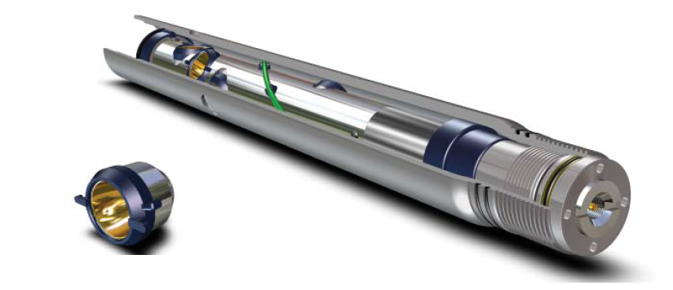
Operational Benefits
Box by pin gun
  Reduces tool string length
  Allows for more perf clusters per run
No subs
  No auxiliary hardware to clean
  No ports, less seals
Charge tube is the conductor
  No wires or wire connections
Insulated unique design shaped charge
  Reduced gun loading time
  No charge clips or pull over tabs on charge tube
IPS 16-22
Mitigating the Problems in Select-Fire Perforating Operations

Slide 9
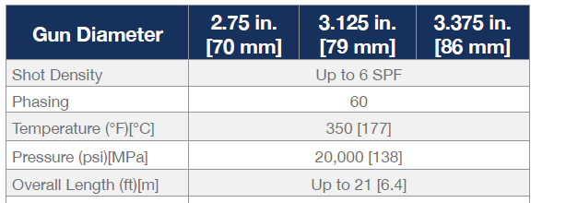
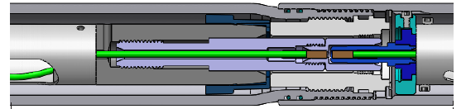
System Overview
Compatible with SDP, GH,BH or Consistent Hole shape charges
Available for Wireline and TCP applications
TCP Version
IPS 16-22
Mitigating the Problems in Select-Fire Perforating Operations

Slide 10
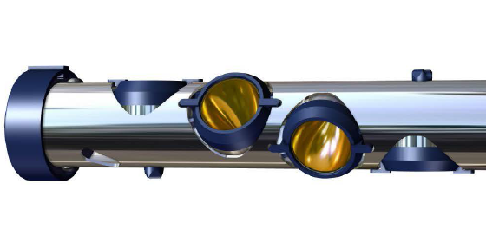
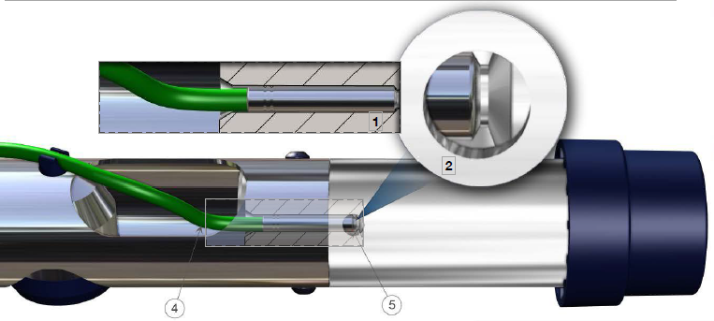
System Overview
Gun Loading
Insulated shape charges and charge tube
End to end ballistic transfer
IPS 16-22
Mitigating the Problems in Select-Fire Perforating Operations

Slide 11
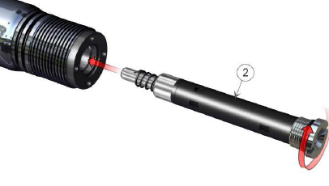
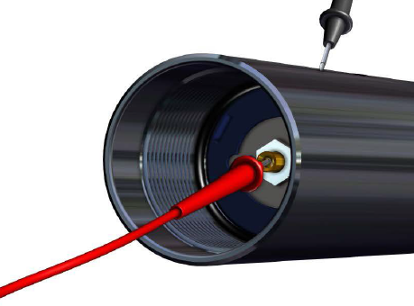
System Overview
Gun Arming
No wires or wire connections
Pressure bulkhead, detonator, and intelligent electronic switch in one package
Ability to check electronic switch and continuity through gun
IPS 16-22
Mitigating the Problems in Select-Fire Perforating Operations

Slide 12
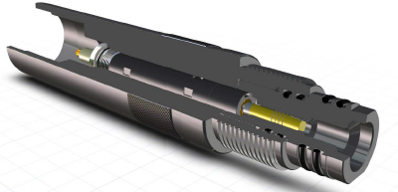
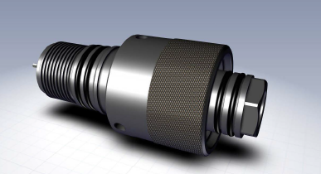
System Overview
Hardware
One piece plug shoot and firing head to reduce length and electrical connections
Uniformed outside diameter quick connection with reduced length
IPS 16-22
Mitigating the Problems in Select-Fire Perforating Operations

Slide 13
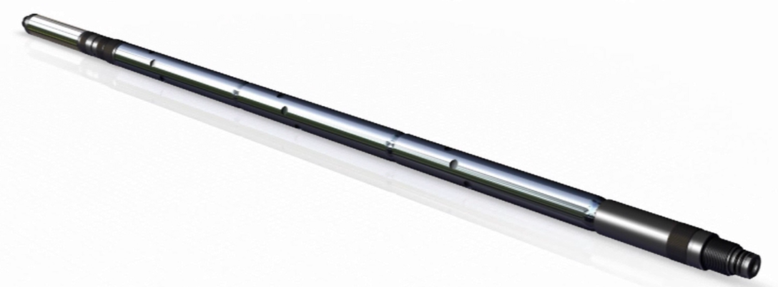
System Overview
Assembly
Screw together system with no wire connections
Allows more guns to be run with reduced tool string length
Guns can be easily downloaded as the job scope changes
IPS 16-22
Mitigating the Problems in Select-Fire Perforating Operations

Slide 14
Conclusion
System mitigates 78% of reported failures and problems in select fire perforating
Provides a RF Safe, API RP 67 compliant, and reliable perforating gun system for the user
Advanced technology in the current market situation
IPS 16-22
Mitigating the Problems in Select-Fire Perforating Operations

