Slide 1


International Perforating Symposium (IPS) 2016
Thermal Decomposition Progress with HMX Explosives

Slide 2

AGENDA/INTRODUCTION
Review previous work (SPE 174209)
Update on API budget and LLNL testing
Detailed results on Perforating Gun/HMX Charge tests
Review of plans for continued work
IPS 16-02
Thermal Decomposition Progress with HMX Explosives

Slide 3
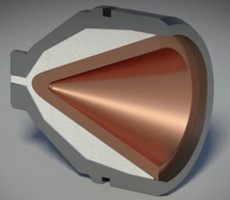
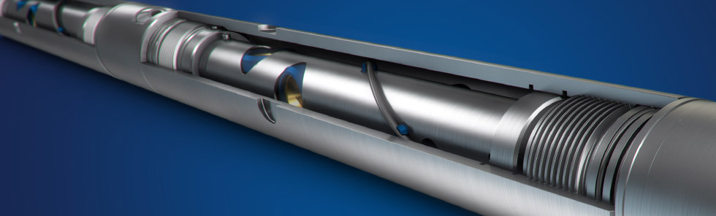
Perforating System
Components
Arming Sub
Detonator – Det Cord Connection
Shaped Charge
Detonating Cord
Perforating Gun
Detonators
Detonating Cord
Shaped Charges
Time Delays
Bi-directional boosters
Perforating Gun
Bottom/Toe
IPS 16-02
Thermal Decomposition Progress with HMX Explosives

Slide 4
Thermal Decomp. Effects
Performance/Economics
Based on time temperature plot provided by manufacturer, HNS was selected over HMX
Result: 30-40% reduction in penetration and an estimated 20% reduction in well performance
HMX
HNS
180 bbl/day
298 bbl/day
IPS 16-02
Thermal Decomposition Progress with HMX Explosives

Slide 5
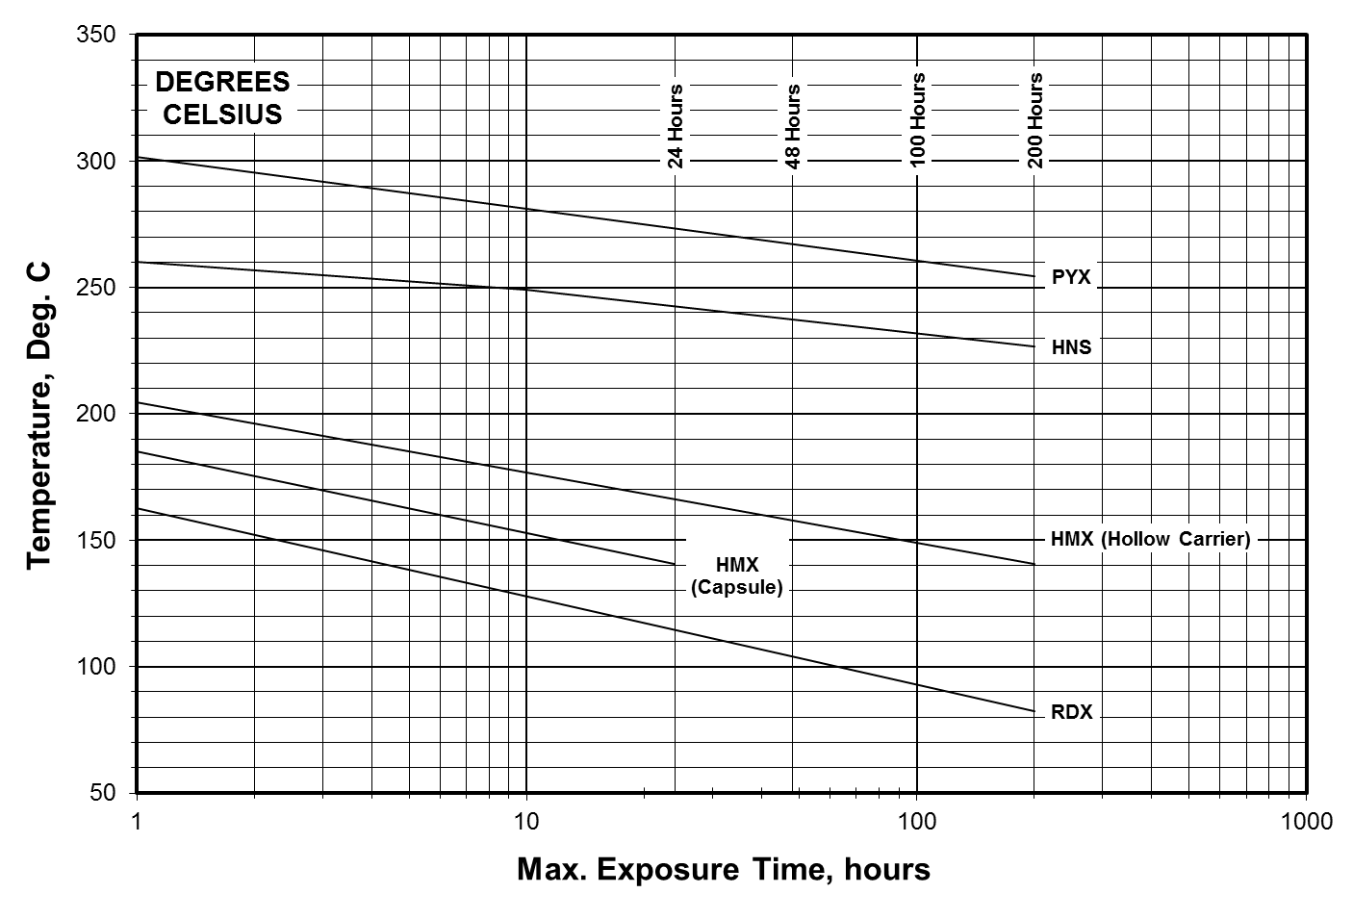
Time-Temp Curve
Single limit based on explosive type
Does not indicate performance degradation
IPS 16-02
Thermal Decomposition Progress with HMX Explosives

Slide 6
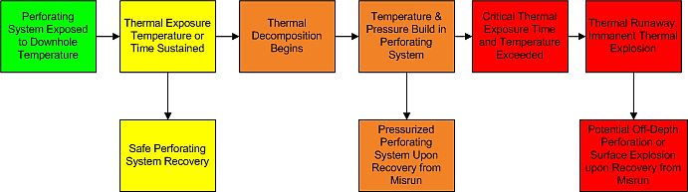
Thermal Decomp. Effects
Safety
Increasing Time and Temperature Exposure
Consequence
IPS 16-02
Thermal Decomposition Progress with HMX Explosives

Slide 7
Balancing Safety and Performance
Critical Temp
Thermal Runaway &
Explosion
Performance Loss
Theoretical improved Time-Temp curve with degrading performance loss as the critical temperature is approached.
Temperature
Performance Limit
Performance Degradation
Thermal Stability Limit
Thermally Stable -Unaffected Performance
Time
IPS 16-02
Thermal Decomposition Progress with HMX Explosives

Slide 8
Previous Work (SPE 174209)
Conclusions
Thermal decomposition of explosives can have significant impact on well productivity and safety
Existing time-temperature curves used for explosive selection
  May be inaccurate over long extrapolations
  Use poorly qualified materials and test setup
  Do not provide all of the information needed to select explosives
Common thermal stability tests
  Do not reflect configuration of explosives in perforating systems
  Do not relate safety and performance
  Measure different aspects of thermal decomposition
IPS 16-02
Thermal Decomposition Progress with HMX Explosives

Slide 9
Previous Work (SPE 174209)
Forward Plan
Immediate
Explosive components testing at manufacturer
Medium Term
Laboratory testing at Lawrence Livermore National Lab with API support
Longer time duration ODTX tests with explosive material from industry relevant blends
Long Term
Scalable model to provide performance and safety guidance for industry through additional testing
Explosive materials
Assess accuracy of existing curves
Identify critical components (i.e. shaped charge, booster, det cord, etc.)
Individual components
Full system testing
IPS 16-02
Thermal Decomposition Progress with HMX Explosives

Slide 10
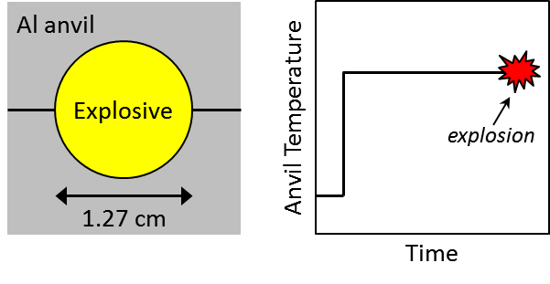
ODTX Test
Safety Test – info on time and temperature at which explosion will occur
Instantaneous exposure to temperature
IPS 16-02
Thermal Decomposition Progress with HMX Explosives

Slide 11
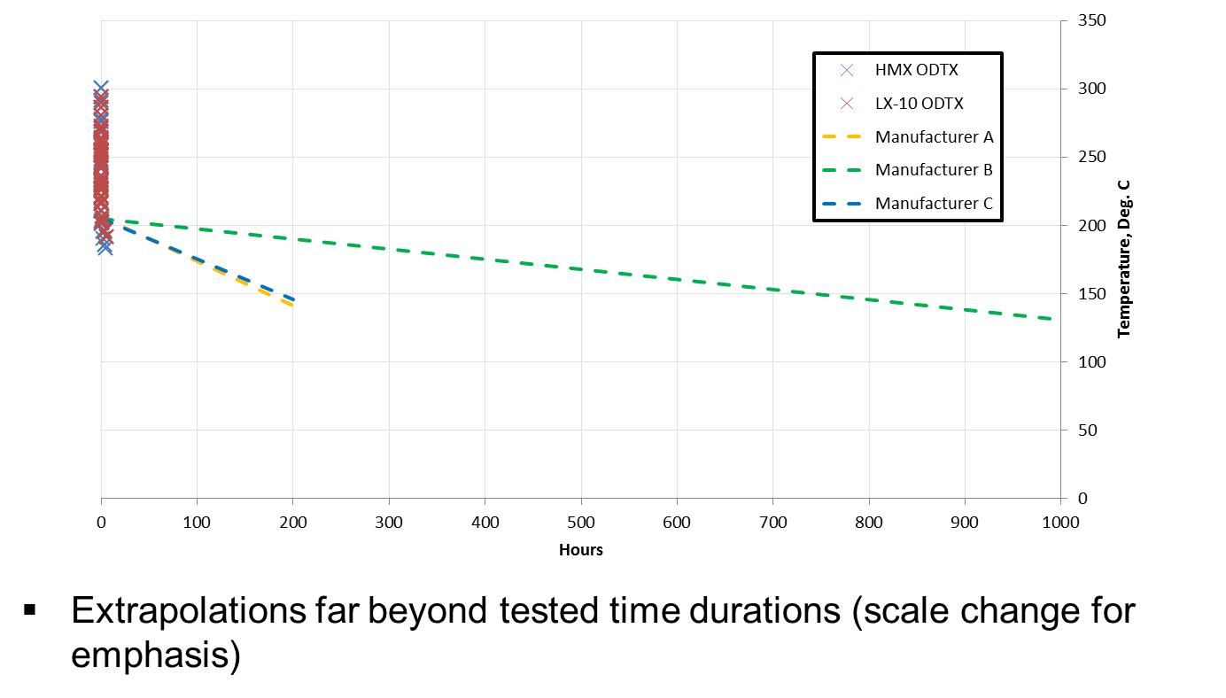
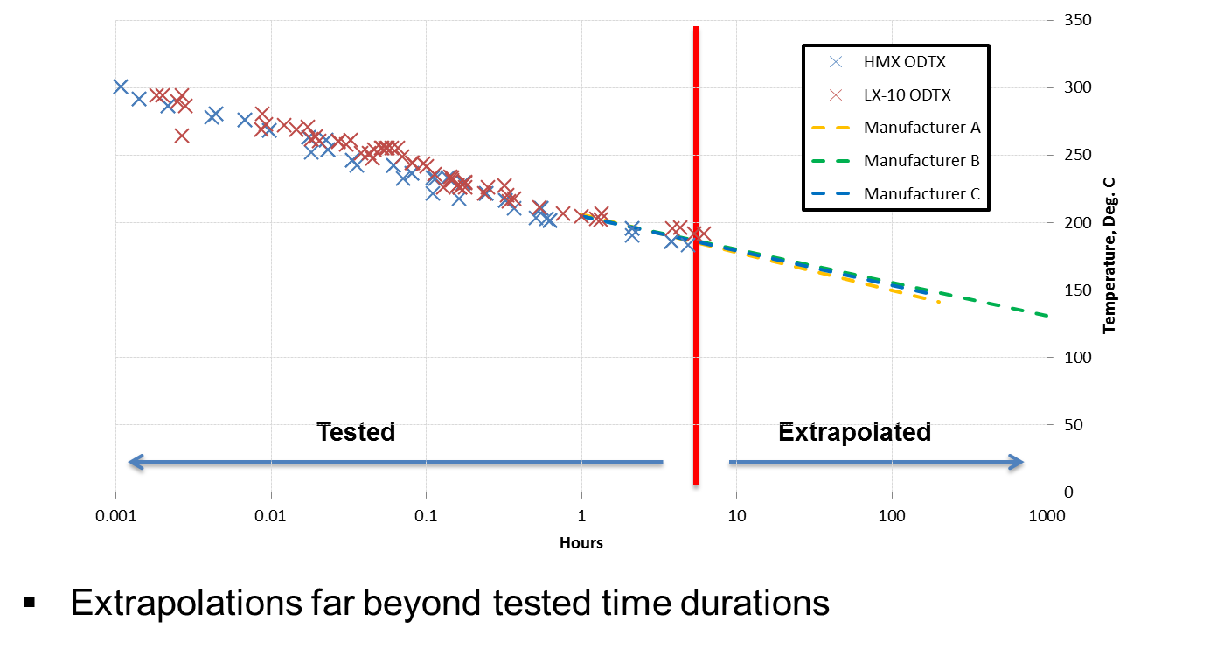
Extrapolations from Lab Tests
Non-Logarithmic Time Scale
Logarithmic Time Scale
IPS 16-02
Thermal Decomposition Progress with HMX Explosives

Slide 12
ODTX vs. Downhole Conditions
Benefits
Disadvantages
Simple Test
Basis for current curves
Amount of historical tests
Potential for fundamental thermal decomposition model (instead of empirical)
Safety only – no performance
Instantaneous exposure temperature dissimilar to downhole exposure
Spherical heat boundary
IPS 16-02
Thermal Decomposition Progress with HMX Explosives

Slide 13
Key Questions to Answer
Where do actual explosive devices fall on the existing time-temp curves?
Do oilfield explosive powders behave the same as previously tested powders (ODTX)
How do ODTX experiments compare to downhole exposure conditions?
Compare device tests to curves
Compare ODTX tests using oilfield powders with previous tests
Compare device tests with ODTX experiments
IPS 16-02
Thermal Decomposition Progress with HMX Explosives

Slide 14
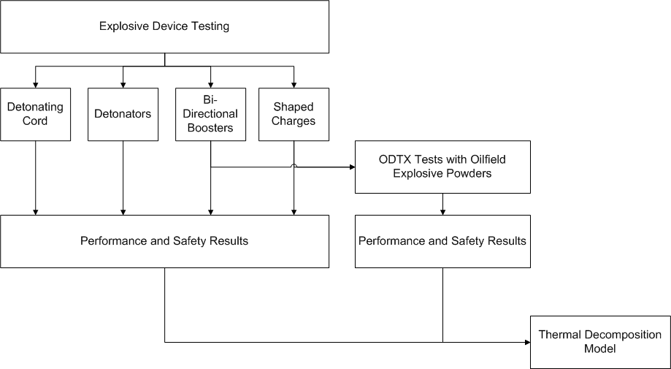
Path
API Approved $150k for Thermal Decomposition study (2016)
Explosive Device Testing
  Initial focus on HMX
  Initial work completed for Shaped Charges
ODTX Testing (LLNL)
  LLNL Phase 1: Shaped Charge Booster
  LLNL Phase 2: Shaped Charge Main
  API & LLNL negotiating contract – expected to begin Phase 1 in Q2
IPS 16-02
Thermal Decomposition Progress with HMX Explosives

Slide 15
Plan
Reserve batches of HMX used in shaped charges
  Booster – pure, fine HMX
  Main – desensitized HMX
Build shaped charges for thermal decomposition experiments under simulated downhole conditions
Supply HMX powders of the same batch for ODTX experiments
IPS 16-02
Thermal Decomposition Progress with HMX Explosives

Slide 16
Device Testing
Simulating Downhole Conditions
Temperature Exposure: ~1 hr ramp to temp.
Test Conditions:
  Loaded in perforating gun (comparable free volume)
  Sealed perforating gun
  Heat applied externally to perforating gun (comparable to downhole exposure)
IPS 16-02
Thermal Decomposition Progress with HMX Explosives

Slide 17
Shaped Charge Test Program
Thermal exposure
  Pre-heat to ~30°F of set temperature (prevent overshoot)
  Target temperatures: 345°F, 365°F, 385°F, 400°F
Test stop conditions
  Thermal event occurs (indicated by temperature measurement)
  Significant time lapse with no thermal event
Conduct standard QC with any remaining shaped charges
IPS 16-02
Thermal Decomposition Progress with HMX Explosives

Slide 18
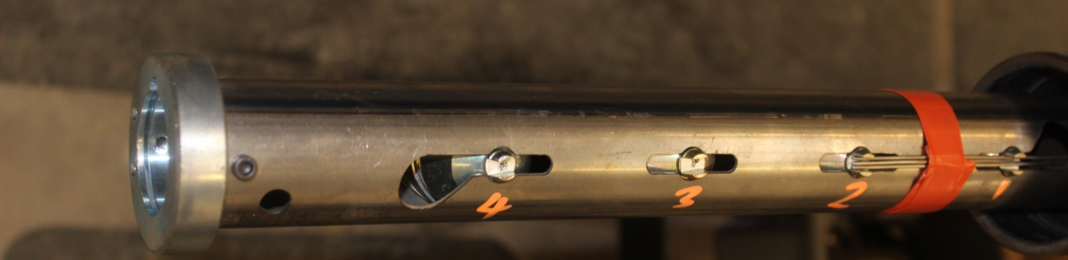
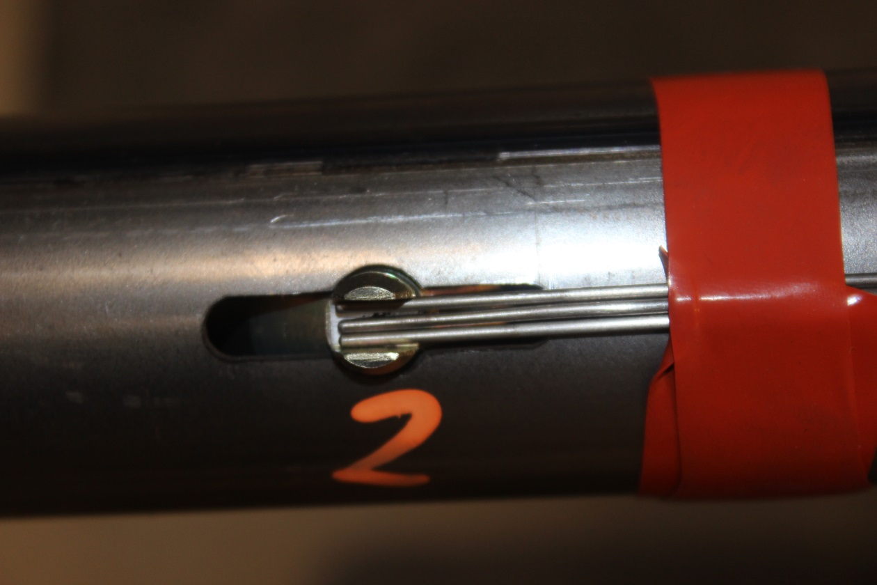
Shaped Charge Test Program
Charge Temperature 1 – data acq.
Charge Temperature 2 – data acq.
Charge Temperature 3 – controller
IPS 16-02
Thermal Decomposition Progress with HMX Explosives

Slide 19
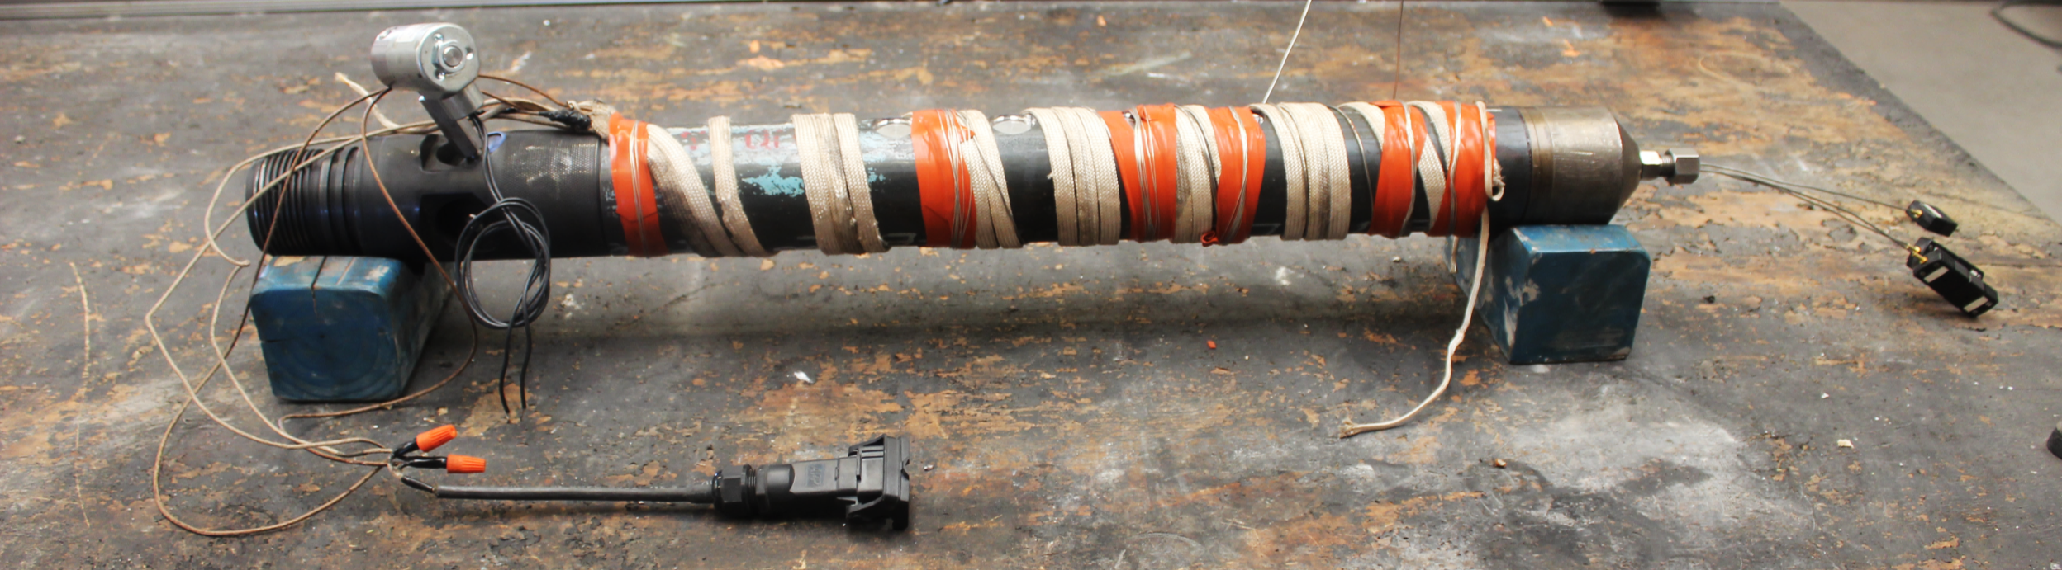
Shaped Charge Test Program
Electronic Pressure Relief Solenoid
Heat Tape/Cable
Charge Thermocouples
3-3/8” 4SPF 0 Degree Perforating Gun
19g HMX DP Charges
IPS 16-02
Thermal Decomposition Progress with HMX Explosives

Slide 20
Results
Summary
Target Temp. | Total Time | Results
345°F | 61 hrs | All 4 charges ok
365°F | 62 hrs | 1 charge deflagrated (12.5 hrs) 3 charges ok
385°F | 14.7 hrs | 1 charge 10% decomp., 5 in. penetration 3 charges ok
400°F | 7.1 hrs* | 1 charge partially jetted 3 charges deflagrated*
IPS 16-02
Thermal Decomposition Progress with HMX Explosives

Slide 21
Results
400°F
Temperature spike from thermal event
Thermal couples damaged, not reading
Note: Controlling thermocouple expelled from gun, undamaged. Temperature control lost. Remaining charges exposed to ~500°F.
IPS 16-02
Thermal Decomposition Progress with HMX Explosives

Slide 22
Results
Unpredictable outcome when existing curve is exceeded
Severity of event appears to increase with temperature
No reactions caused ruptures in the perforating gun (although these results could be different in a full explosive train).
IPS 16-02
Thermal Decomposition Progress with HMX Explosives

Slide 23
Discussion
Data is applicable to shaped charges only
Reminder: Initiation is a statistical event (i.e. 1 out 4 @ 365°F)
Other explosive components likely behave differently
More severe reactions such as Deflagration to Detonation Transitions may occur in full perforating systems with other more sensitive components in the explosive train
IPS 16-02
Thermal Decomposition Progress with HMX Explosives

Slide 24
Secondary Results
Performance Data
Exposure time significantly beyond predicted value
Performance may decrease under long over-exposure even without full decomposition
  Further testing is required to understand the effects of exposure time at a given temperature
  Testing should evaluate performance at short and long exposure times
Unclear transition between performance loss and total degradation
IPS 16-02
Thermal Decomposition Progress with HMX Explosives

Slide 25
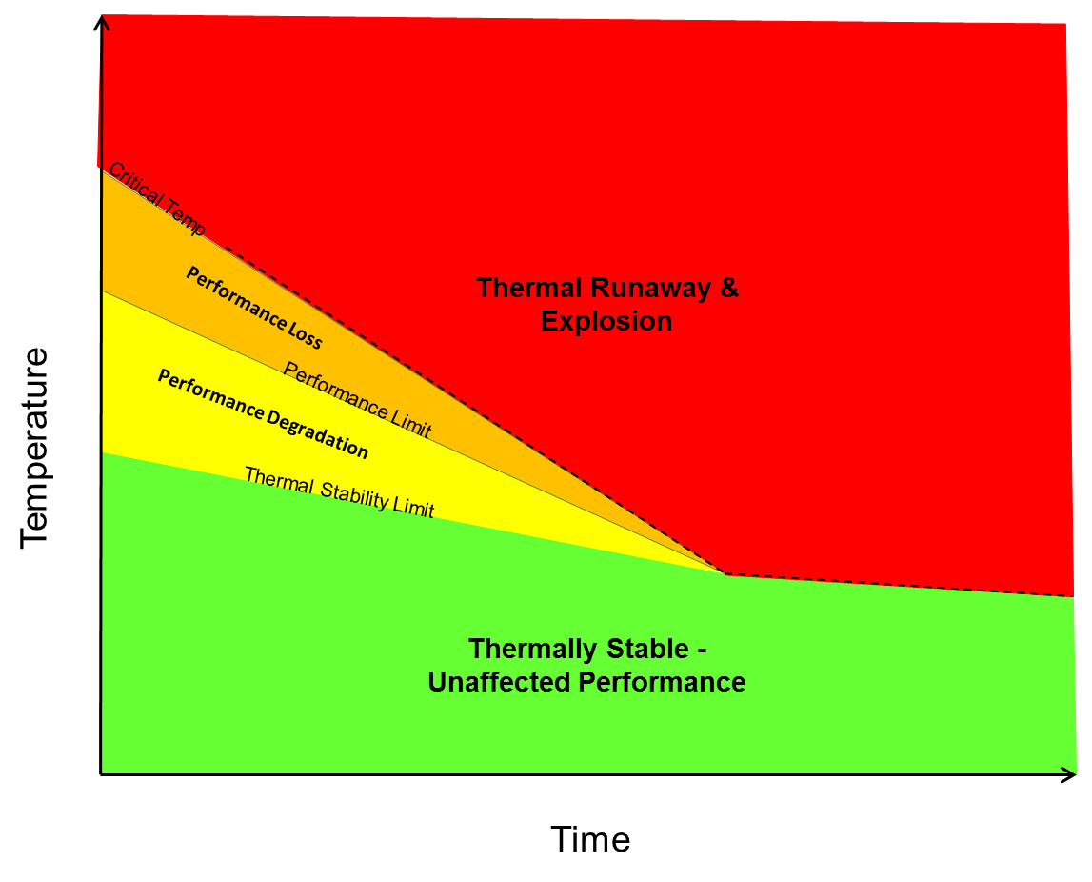
Refined Theoretical Curve
Original
Refined
Thermal Runaway & Explosion
Temperature
Performance Loss
Performance Degradation
Thermally Stable –
Unaffected Performance
Time
IPS 16-02
Thermal Decomposition Progress with HMX Explosives

Slide 26
Closing Remarks & Continued Work
Premature to draw conclusions from results – existing time-temperature curves should continue to be used!
Expand test range to +400°F and 200+ hours
Compare results with ODTX tests from LLNL
Evaluate exposure time effects on performance
Expand testing to other explosive components
Expand testing to full system for interactions
IPS 16-02
Thermal Decomposition Progress with HMX Explosives

